Slide 1
Scoring an alignment with substitution matrices
Generating an alignment with dynamic programming
Local alignments
Multi-threaded dynamic programming

Slide 2
pairwise alignment algorithms
Given two sequences: EVLISPISHERE ELVIRAISHERE
find the best alignment:
EVLISPISHERE
ELVIRAISHERE
First we define what we mean by best alignment
From this we will define a substitution matrix

Slide 3
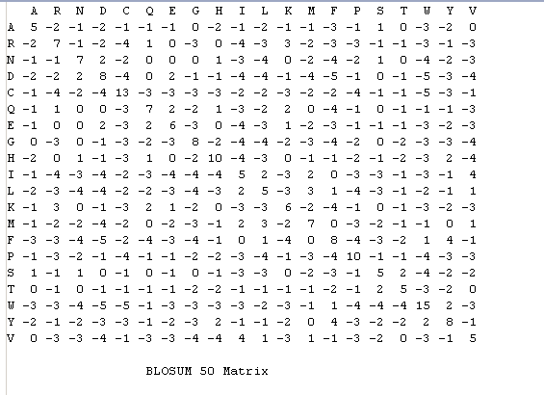
A substitution matrix is used to score how likely two residues are found in a multiple
sequence alignment
Here is the BLOSSUM 50 Matrix
https://github.com/afodor/afodor.github.io/blob/master/classes/prog2015/Blosum50.txt

Slide 4
Now:
We are going to define a class to parse the Blossum matrix.
You will implement this class…
(……)
Methods will return the score given two residues.

Slide 5
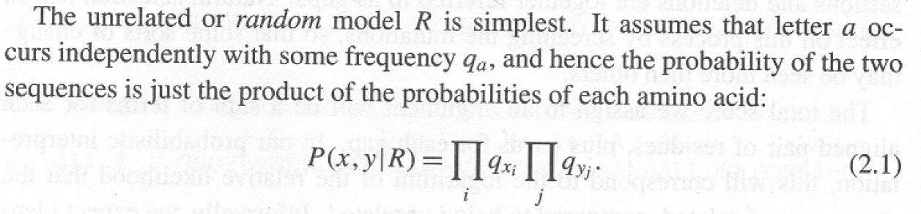
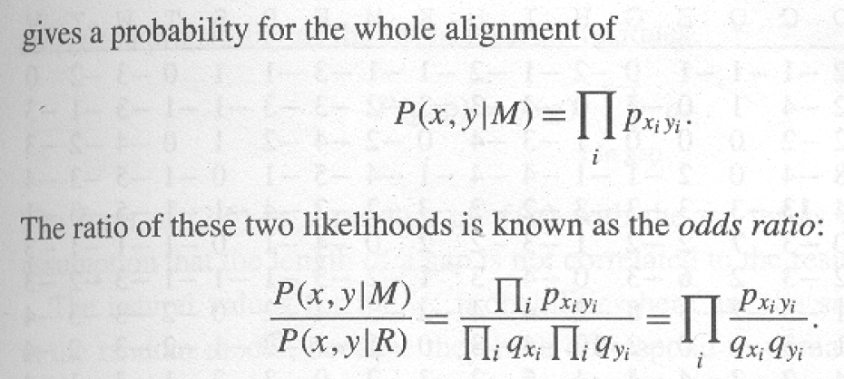
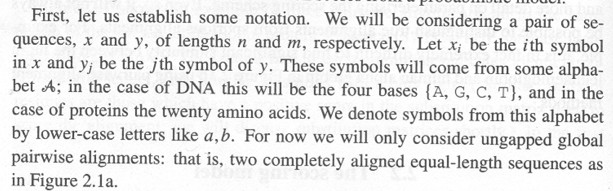
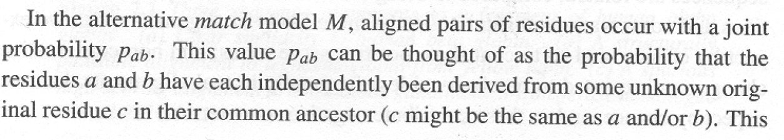
This, it turns out is the formula for scoring our alignment
Consider the case of an
ungapped global alignment
For each pair or residues in each column, what is the
probability we would observe
those residues by chance?
For each pair of residues in
each column, what is the
probability we observe those residues
because of a common ancestor?
Durbin et al Biological Sequence Analysis: Probabilistic Models of Proteins and Nucleic Acids

Slide 6
For each pair of residues in the alignment,
This is the value of the substitution matrix
(or will be once we log it)
This is the score for the whole alignment
EVLISPISHERE
ELVIRAISHERE
Here x=E, y=E
Here x=R, y=S

Slide 7
Let’s define p(sequence|model).
Given a particular die, what is the probability of observing a sequence…
For DNA, if we have a fair die:
p(A) = p(C) = p(G) = p(T) = 0.25
Then the p(“A”,”C”| “fair die model” ) =
The probability we would observe and A and a C =
0.25 * 0.25 = 0.0625
For proteins, if we have a fair die.
p(A) = p(C) = p(D) …. p(Y) = 0.05
Then the p(“A”,”Y” | “fair die model” ) =
0.05 * 0.05 = 0.0025

Slide 8
But we can make more realistic models.
Instead of a “fair” die, consider a die that has the same frequencies as all
amino acids in a protein.

Slide 9
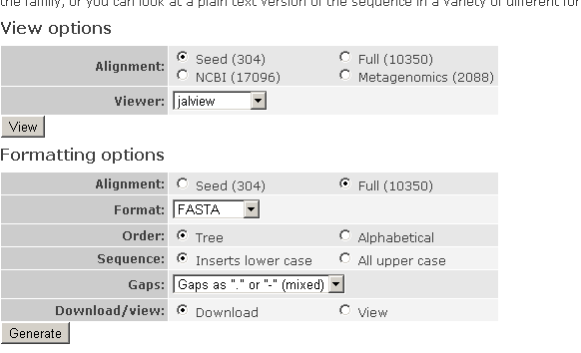
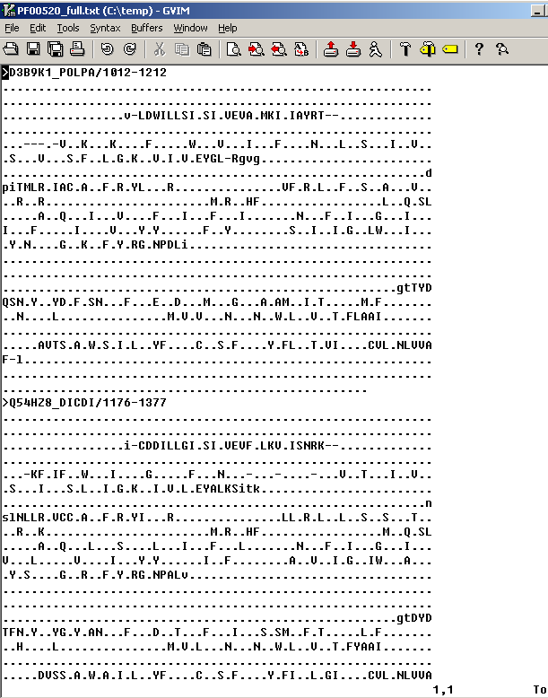
Grab some random (ion channel pore) protein alignment off the web…

Slide 10
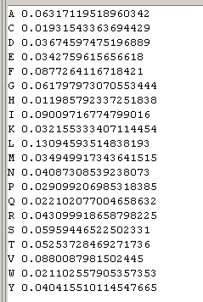
Our random model:
A 20-sided die that “rolls” an Alanine ~6% of the time
a Cys ~1.9% of the time
and so forth
(since Alanine is ~6% of the residues, Cys is ~1.9% and so forth)
q_{A}
q_{C}
The p(sequence|Random model) =
the product of all the dice rolls…
q_{D}
This should look familiar!
It is closely related to the results of your homework!

Slide 11
It is very unlikely that you will pick up a “protein” die and roll the entire alignment!
To get the probability of
our sequence under a
random model, we
multiply all the probabilities
together

Slide 12
What about the Match model?

Slide 13
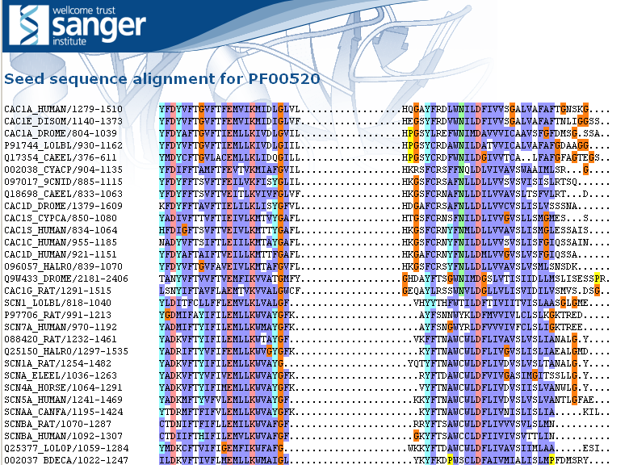
Let’s calculate p(x,y|M) naively
We’ll define p(x,y|M) as the frequency of seeing a pair of residues aligned against each other from the first 200 pfam families…
Considering all pairwise sequences in the alignment, how often do we see each substitution?

Slide 14
Let’s calculate p(x,y|M) naively
We’ll define p(x,y|M) as the frequency of seeing a pair of residues aligned against each other from the first 200 pfam families…
Considering all pairwise sequences in the alignment, how often do we see each substitution?

Slide 15
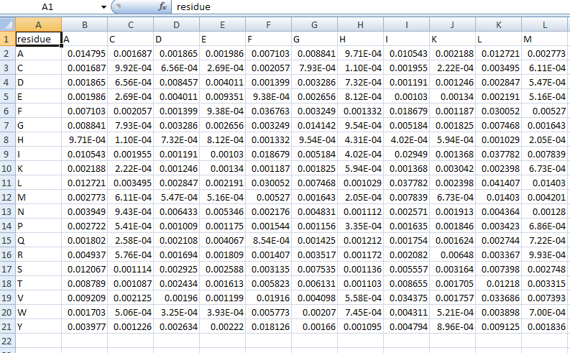
Within the alignment of the first 200 residues, an A to A transition occurred ~1.5% of the time
An estimate of p_{aa}
Assuming sequences in an alignment are
Related, how often does an ala stay an ala?

Slide 16
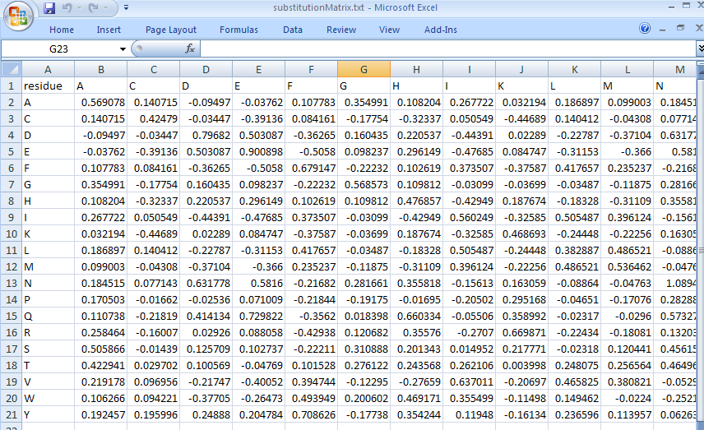
Our pfam derived substitution matrix
Ala is most likely to stay an Ala, but Gly or Ser (similar AAs) or almost as good…
Isoleucine is likely to stay an ILE, but LEU is almost as good (and VAL is a little better!)

Slide 17
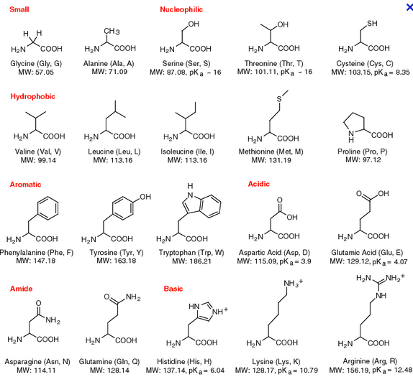
http://www.neb.com/nebecomm/tech_reference/images/amino.gif

Slide 18
How do we compare to an “official” substituion matrix?

Slide 19
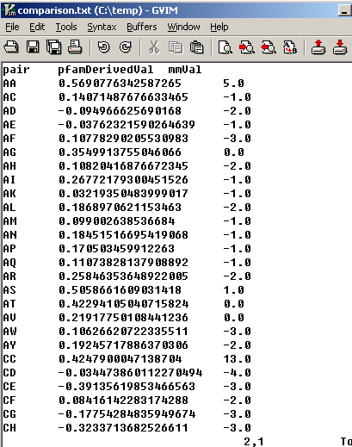
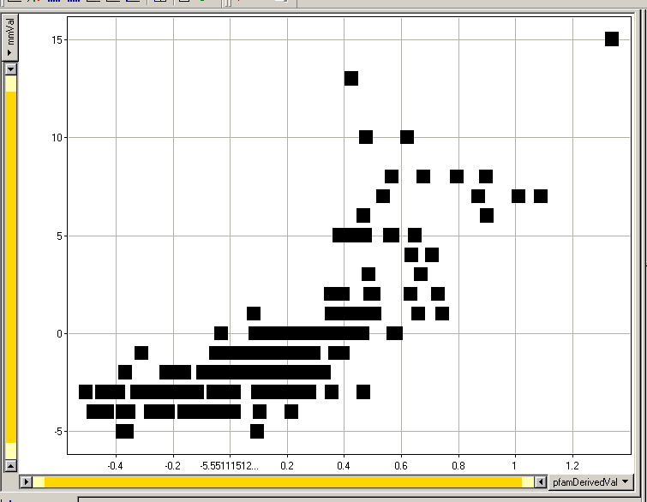
We have broad but imperfect agreement between BLOSSOM 50 and our own
(somewhat sloppily derived!) PFAM substituion matrix.
CC
HH
PP
Blossom Derived
PFAM Derived
In this ion channel pore, HH, CC and PP are observed less often than in the Blossom derived

Slide 20
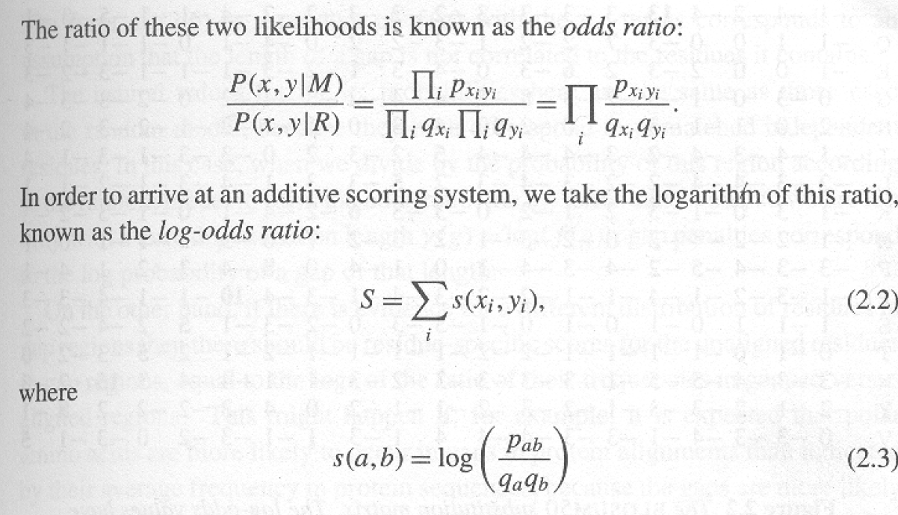
A substitution matrix is just a description of a training set describing what it means to have a match
What you expect from matched residues
What you expect from unmatched residues

Slide 21
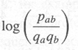
This is the “score” of the alignment…
By working in log space, we avoid overflow errors.
The substitution matrix saves from having to calculate over and over again.
It is integer because integer calculations are more efficient.
(trade a little bit of accuracy for speed and memory)

Slide 22
Therefore most substitution matrices are integers (representing rounded log probabilities)

Slide 23
A key assumption is independence. What happens in one
part of the sequence does not effect another..
This is a terrible assumption for structural RNA…

Slide 24
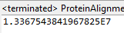
But let’s return to our alignment…
EVLISPISHERE
ELVIRAISHERE
We can think of this odd-ratio as how much more likely is it
that the sequences are related that we would expect by chance?
The odds are 13 million to 1 that we could have seen such a good alignment by chance
(given our “background” model derived from the PFAM alignment)
(But that 13 million to 1 is a little mis-leading…)

Slide 25
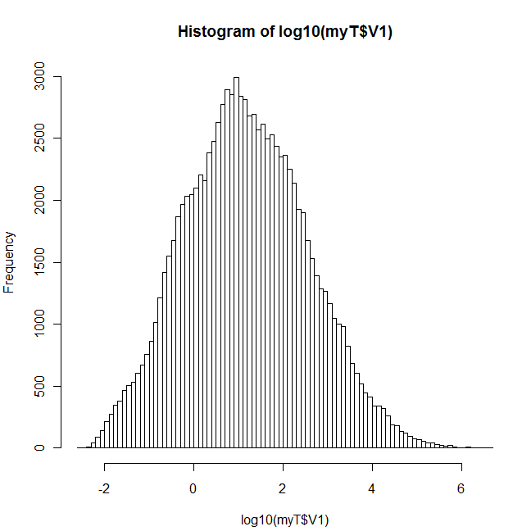
If we (many times) randomly scramble the order of residues in our alignment
Note that this is not centered at zero..
If the assumptions of the training set
are off by even a little, the log-odds ratio
can be biased in one direction or another.
“ELIVSISEVERYWHERE” does not have
the expected background distribution
(so the 13 million to 1 estimate is an
over-estimate of the significance caused by
an inadequately defined training set)

Slide 26
Scoring an alignment with substitution matrices
Generating an alignment with dynamic programming
Local alignments

Slide 27
We have our scoring function…
:
Now we want to go the other way, given a scoring function
and two sequences, can we align them to yield the highest
score under the scoring function…

Slide 28
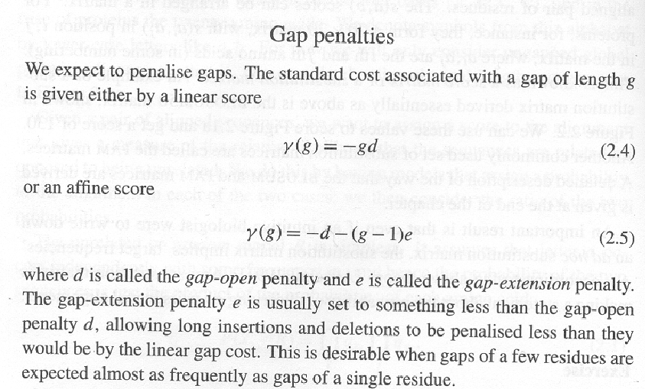
We need to work out a way to score gaps….

Slide 29
Given two sequences and a scoring function
(substitution matrix + gap function), find the best alignment
(highest scoring alignment).
Why not just calculate all the possible alignments?

Slide 30
Why not just calculate all the possible alignments?
N₁N₂ ----- N₃N₄N₅
-- M₁M₂M₃M₄M₅ ---
An alignment is equivalent to…
N₁ N₂M₁ M₂ M₃ M₄ M₅N₃ N₄ N₅
The # of ways of intercalating two sequences of length N and M
(while preserving the order of the symbols) is:
Given two sequences (both of 100 bp) there are
=
90,548,514,656,103,281,165,404,177,077,484,163,874,504,589,675,413,336,841,320
If you could score 1,000 alignments/second, you would still be
Looking at > 10⁴⁵ years…

Slide 31
Dynamic programming…Will guarantee the best score in
time O(M * N) (and memory M *N).
The key assumption… independence..
Calculate the scores of the sub-alignments first…

Slide 32
The big idea.. If we know that for “AWC” and “ATC” that
this is the best alignment…
AWC
ATC
We can “remember” that and use that alignment as the base
for any longer pair of sequences that start the same way.
We don’t have to recalculate that score (or the fact that that is
the best alignment) for every pair of sequences that starts
the same way….
Again, this works because of the assumption of independence.
Nothing we will add later will change the fact that for
“AWC” and “ATC” the above is the best alignment.

Slide 33
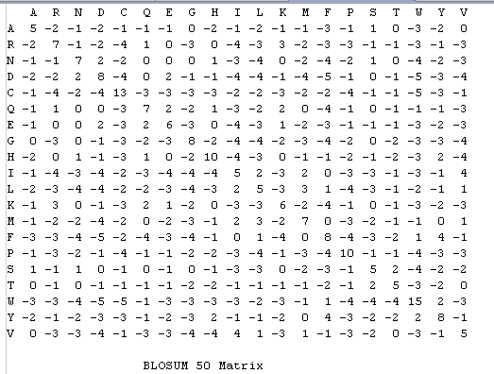
We take the example in the book*…
PAWHEAE
HEAGAWGHEE
Blosom50 matrix;
Constant (linear) gap penalty -8
Durbin et al Biological Sequence Analysis: Probabilistic Models of Proteins and Nucleic Acids

Slide 34
PAWHEAE
HEAGAWGHEE
H E A G A W G H E E
P
A
W
H
E
A
E
When setting this up, put one extra row and one extra column
(as if there is an invisible residue at the start of each sequence)

Slide 35
H E A G A W G H E E
P
A
W
H
E
A
E
Start in the lower right corner.
If there is an “up arrow” emit
-
E

Slide 36
H E A G A W G H E E
P
A
W
H
E
A
E
Start in the lower right corner.
Two “up arrows” emit
- -
E A

Slide 37
H E A G A W G H E E
P
A
W
H
E
A
E
Start in the lower right corner.
If there is a “diagonal arrow” emit
E
E

Slide 38
H E A G A W G H E E
P
A
W
H
E
A
E
Start in the lower right corner.
Two “diagonal arrows” emit
EE
EA

Slide 39
H E A G A W G H E E
P
A
W
H
E
A
E
Start in the lower right corner.
A “right arrow” emits
E
-

Slide 40
H E A G A W G H E E
P
A
W
H
E
A
E
Start in the lower right corner.
Two “right arrows” emits
EE
--

Slide 41
H E A G A W G H E E
Finish
P
A
W
H
E
A
E
Start
We can think of an alignment as choosing the “best” path from
start to finish. There are
alignments
(possible paths) from start to finish.

Slide 42
H E A G A W G H E E
Finish
P
A
W
H
E
A
E
Start
We “traceback” to read the backwards alignment from the path.

Slide 43
H E A G A W G H E E
Finish
P
A
W
H
E
A
E
Start
We “traceback” to read the backwards alignment from the path.
E
E

Slide 44
H E A G A W G H E E
Finish
P
A
W
H
E
A
E
Start
We “traceback” to read the backwards alignment from the path.
EE
EA

Slide 45
H E A G A W G H E E
Finish
P
A
W
H
E
A
E
Start
We “traceback” to read the backwards alignment from the path.
EEH
EAE

Slide 46
H E A G A W G H E E
Finish
P
A
W
H
E
A
E
Start
We “traceback” to read the backwards alignment from the path.
EEHG
EAEH

Slide 47
H E A G A W G H E E
Finish
P
A
W
H
E
A
E
Start
We “traceback” to read the backwards alignment from the path.
EEHGW
EAEH-

Slide 48
H E A G A W G H E E
Finish
P
A
W
H
E
A
E
Start
We “traceback” to read the backwards alignment from the path.
EEHGWA
EAEH-W

Slide 49
H E A G A W G H E E
Finish
P
A
W
H
E
A
E
Start
We “traceback” to read the backwards alignment from the path.
EEHGWAG
EAEH-W-

Slide 50
H E A G A W G H E E
Finish
P
A
W
H
E
A
E
Start
We “traceback” to read the backwards alignment from the path.
EEHGWAGA
EAEH-W-A

Slide 51
H E A G A W G H E E
Finish
P
A
W
H
E
A
E
Start
We “traceback” to read the backwards alignment from the path.
EEHGWAGAE
EAEH-W-A-

Slide 52
H E A G A W G H E E
Finish
P
A
W
H
E
A
E
Start
We “traceback” to read the backwards alignment from the path.
EEHGWAGAEH
EAEH-W-A-P

Slide 53
H E A G A W G H E E
Finish
P
A
W
H
E
A
E
Start
We “traceback” to read the backwards alignment from the path.
This is not a very good alignment!
EEHGWAGAEH
EAEH-W-A-P

Slide 54
How do we find the best alignment?

Slide 55
H E A G A W G H E E
0
P
A
W
H
E
A
E
We start by putting a zero to represent a zero length
alignment having a score of zero.

Slide 56
H E A G A W G H E E
0
-8
-16
-24
-32
-40
-48
-56
-64
-72
-80
P
-8
A
-16
W
-24
H
-32
E
-40
A
-48
E
-56
We can fill out the edges representing sequence aligned to gaps

Slide 57
H E A G A W G H E E
0
P
A
X
W
H
E
A
E
Consider this box: What is the best way to Align “PA” and “”.
Well. There is only way!
--
PA
(score –16)
Moreover, this alignment “builds on” “P” and “” (hence the arrows)

Slide 58
H E A G A W G H E E
0
-8
-16
-24
-32
-40
-48
-56
-64
-72
-80
P
-8
A
-16
W
-24
H
-32
E
-40
A
-48
E
-56
X
The box marked with X represents:
-------
PAWHEAE

Slide 59
H E A G A W G H E E
0
-8
-16
-24
-32
-40
-48
-56
-64
-72
-80
P
-8
-16
A
-16
W
-24
H
-32
E
-40
A
-48
E
-56
Consider this box: What is the best way to align “H” and “P”
One Option:
-H
P-
We’ve already calculated the score of
-
P
So if we take this option the new score is –8 + (-8)

Slide 60
H E A G A W G H E E
0
-8
-16
-24
-32
-40
-48
-56
-64
-72
-80
P
-8
-16
-16
A
-16
W
-24
H
-32
E
-40
A
-48
E
-56
Another option:
H-
-P
We’ve already calculated the score of
H
-
So if we take this option the new score is –8 + (-8)

Slide 61
H E A G A W G H E E
0
-8
-16
-24
-32
-40
-48
-56
-64
-72
-80
P
-2
-8
-16
-16
A
-16
W
-24
H
-32
E
-40
A
-48
E
-56
Another option:
H
P
This score is 0 –2

Slide 62
H E A G A W G H E E
0
-8
-16
-24
-32
-40
-48
-56
-64
-72
-80
P
-8
-2
A
-16
W
-24
H
-32
E
-40
A
-48
E
-56
We take the highest of our three options
And we remember from where the choice came from

Slide 63
H E A G A W G H E E
0
-8
-16
-24
-32
-40
-48
-56
-64
-72
-80
P
-8
-2
A
-16
W
-24
H
-32
E
-40
A
-48
E
-56
We read this as: If we had to align “H” and “P”,
H
P
is better than
H-
-P
or
-H
P-

Slide 64
H E A G A W G H E E
0
-8
-16
-24
-32
-40
-48
-56
-64
-72
-80
P
-8
-2
-10
A
-16
W
-24
H
-32
E
-40
A
-48
E
-56
Another option:
On to the next box. What’s the best way to align
“HE” and “P”
HE
P-
H
P
We’ve already calculated , so the new value
is –2 + (-8)

Slide 65
H E A G A W G H E E
0
-8
-16
-24
-32
-40
-48
-56
-64
-72
-80
P
-24
-8
-2
-10
A
-16
W
-24
H
-32
E
-40
A
-48
E
-56
Another option:
On to the next box. What’s the best way to align
“HE” and “P”
HE-
--P
HE
--
We’ve already calculated , so the new value
is –16 + (-8)

Slide 66
H E A G A W G H E E
0
-8
-16
-24
-32
-40
-48
-56
-64
-72
-80
P
-9
-8
-2
-24
-10
A
-16
W
-24
H
-32
E
-40
A
-48
E
-56
Another option:
On to the next box. What’s the best way to align
“HE” and “P”
HE
-P
H
-
We’ve already calculated , so the new value
is –8 + (-1)

Slide 67
H E A G A W G H E E
0
-8
-16
-24
-32
-40
-48
-56
-64
-72
-80
P
-8
-2
-9
A
-16
W
-24
H
-32
E
-40
A
-48
E
-56
If we have to align “HE” and “P”
So
HE
-P
is better than
HE
P-
HE-
--P
or

Slide 68
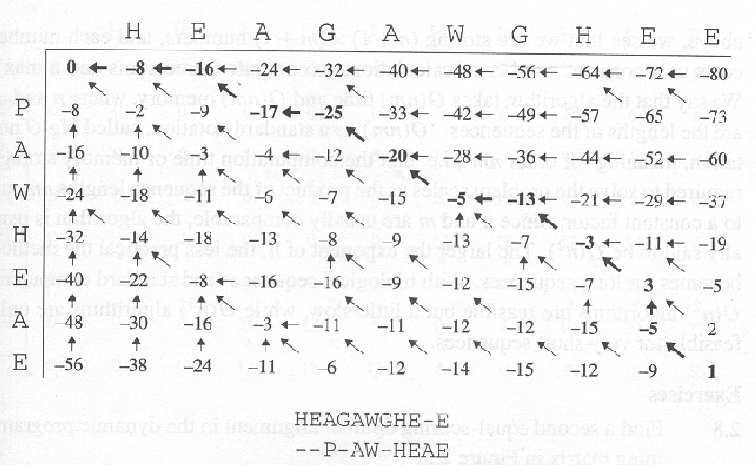
The completed matrix (from the book)

Slide 69
Scoring an alignment with substitution matrices
Generating an alignment with dynamic programming
Local alignments
Multi-threaded dynamic programming

Slide 70
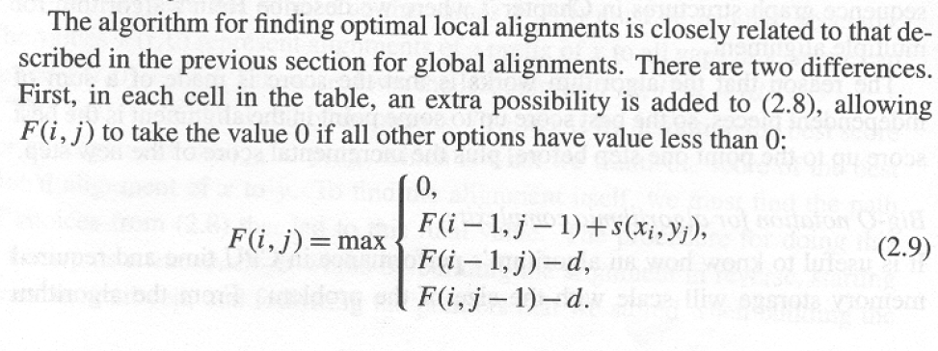
Local alignment is often much more useful than global alignment.
There is usually very little reason to think that 2 sequences will
be related across their entire length….
Local alignment is a pretty trivial modification to global alignment…
Smith-Waterman algorithm….
A favorite algorithm in bioinformatics

Slide 71
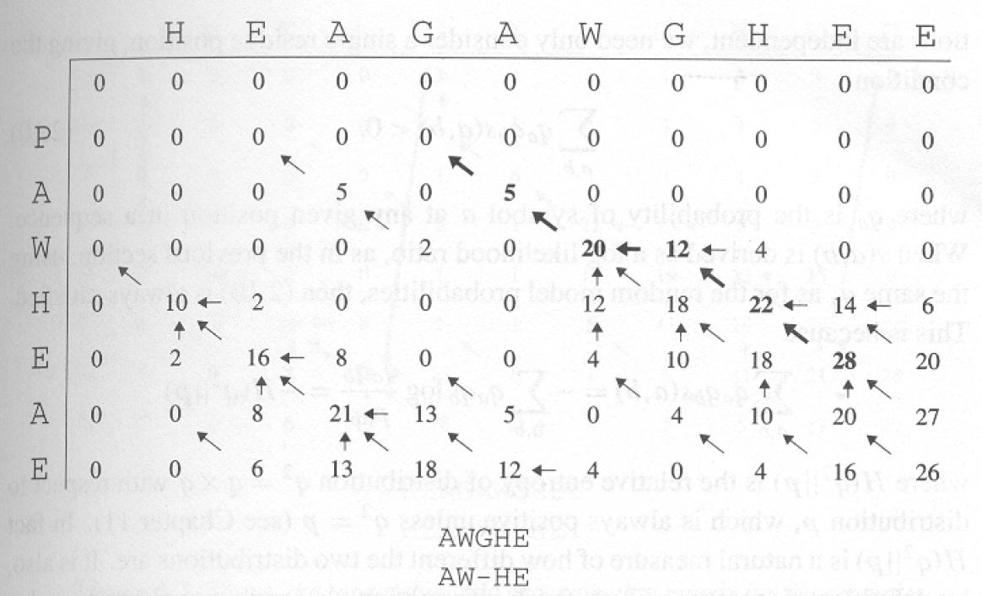
We start with the highest score rather than the lower-right corner.
We end with a 0 rather than the left-hand corner.
Local alignment always is always relative to a threshold…

Slide 72
Smith Waterman is very slow O(N*M)….
If there is a database of X sequences, a search of the database is
O(X*N*M) where N is the query length and M is the average
length of the sequence in the database.
Much too slow to search a database of genomic scale…

Slide 73
Scoring an alignment with substitution matrices
Generating an alignment with dynamic programming
Local alignments
Multi-threaded dynamic programming

Slide 74
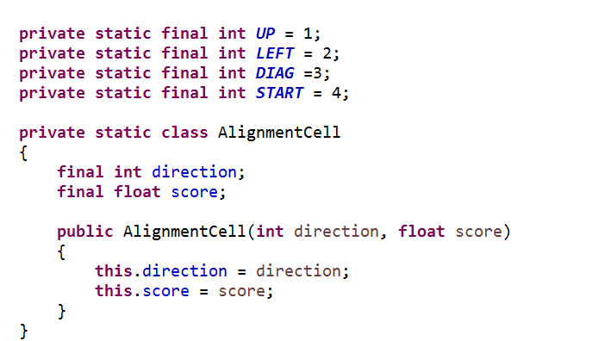
Two dimensional grid of immutable AlignmentCell objects…
https://github.com/afodor/metagenomicsTools/blob/master/src/dynamicProgramming/NeedlemanWunschMultiThreaded.java

Slide 75
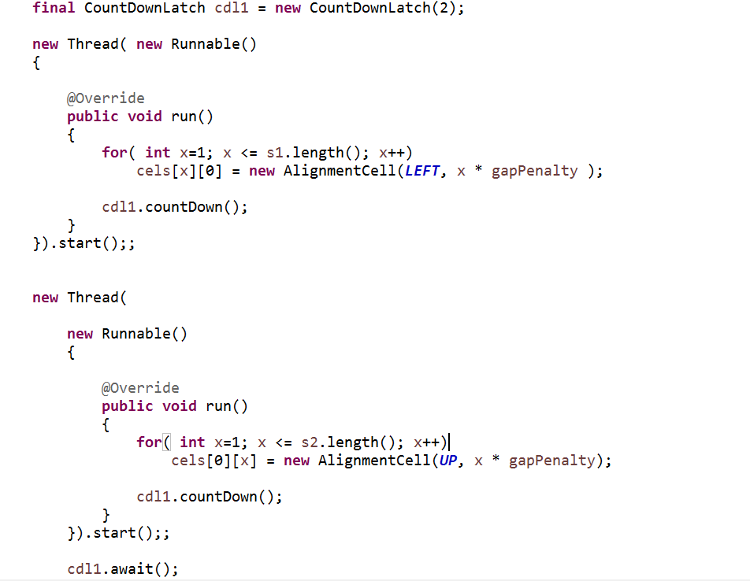
We can fill in the (linear) gap penalty trivially with two threads…
https://github.com/afodor/metagenomicsTools/blob/master/src/dynamicProgramming/NeedlemanWunschMultiThreaded.java

Slide 76
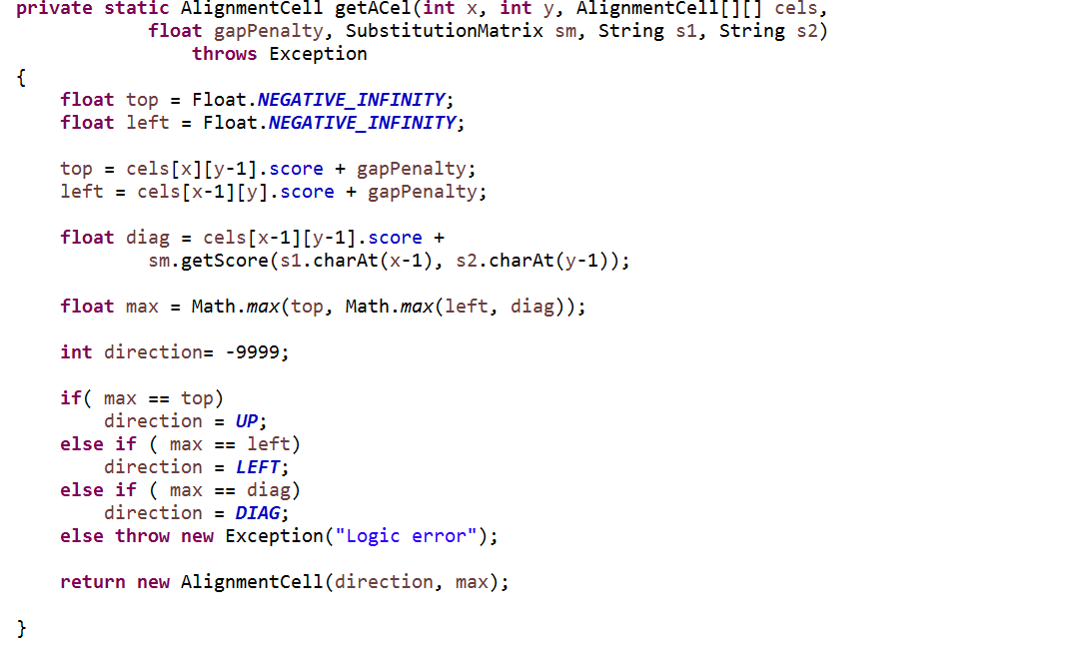
With a linear gap penalty, we can define a method to fill in a given cell…
(the checked in code also can deal with affine gap penalties, but that is not shown in this slide..)
https://github.com/afodor/metagenomicsTools/blob/master/src/dynamicProgramming/NeedlemanWunschMultiThreaded.java

Slide 77
Our strategy (in pictures….) We start two threads….
H E A G A W G H E E
0
-8
-16
-24
-32
-40
-48
-56
-64
-72
-80
P
-8
A
-16
W
-24
H
-32
E
-40
A
-48
E
-56
Each time the horizontal thread finishes, it checks to see how far the vertical thread has gotten

Slide 78
H E A G A W G H E E
0
-8
-16
-24
-32
-40
-48
-56
-64
-72
-80
P
-8
A
-16
W
-24
H
-32
E
-40
A
-48
E
-56
Let’s say when the horizontal thread is ready for the next row, the vertical thread
has finished the first two columns.

Slide 79
H E A G A W G H E E
0
-8
-16
-24
-32
-40
-48
-56
-64
-72
-80
P
-8
A
-16
W
-24
H
-32
E
-40
A
-48
E
-56
The next row doesn’t have to repeat the work of the vertical threads, saving time…

Slide 80
H E A G A W G H E E
0
-8
-16
-24
-32
-40
-48
-56
-64
-72
-80
P
-8
A
-16
W
-24
H
-32
E
-40
A
-48
E
-56
Likewise, vertical thread can start the next column at a lower point in the grid…

Slide 81
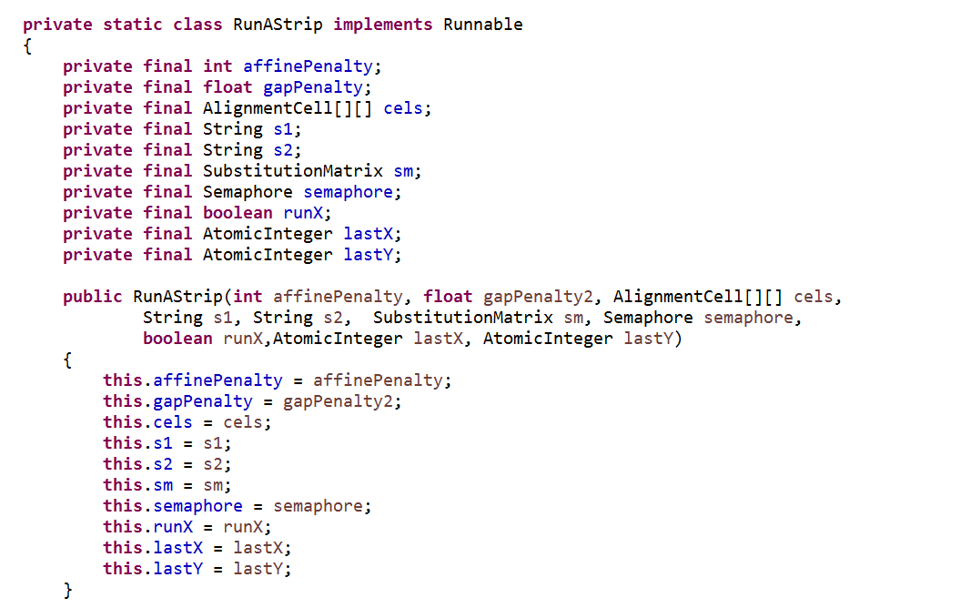
In code….
The constructor for our Worker class…
Could have just as easily used a CountDownLatch

Slide 82
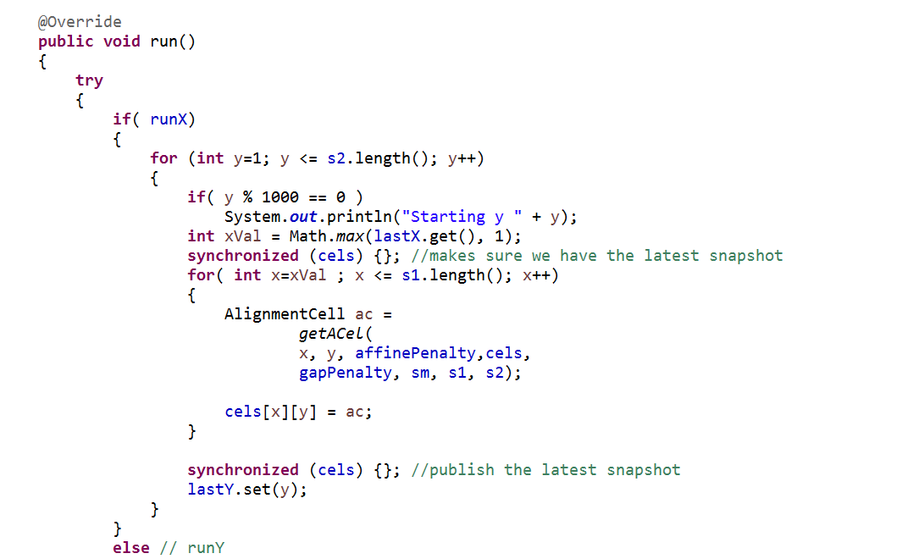
Our run method showing the horizontal thread….
Communicate to the vertical thread where it can start
The synchronized {cels} make sure we grab and publish our results after each row…

Slide 83
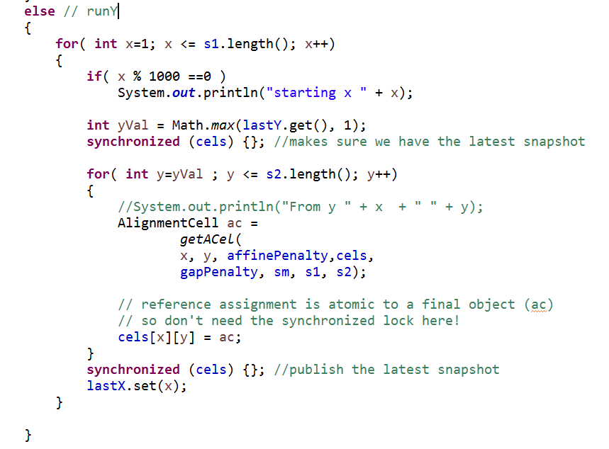
And here is the vertical thread….

Slide 84
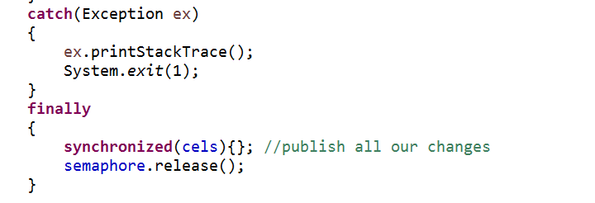
Our cleanup code at the end of the run method…
If any thread dies, they all die!
This synchronized is not really necessary
(we published at the end of each double for loop)
but will only trigger two additional locks
(one as each thread terminates) so doesn’t
really cost us that much…

Slide 85
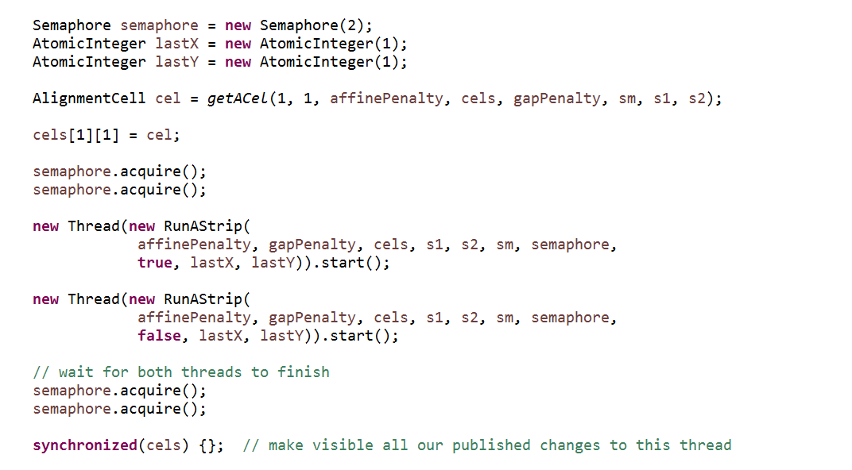
We just need to kick off and wait for these threads….
Make sure we see what the threads have published!

Slide 86
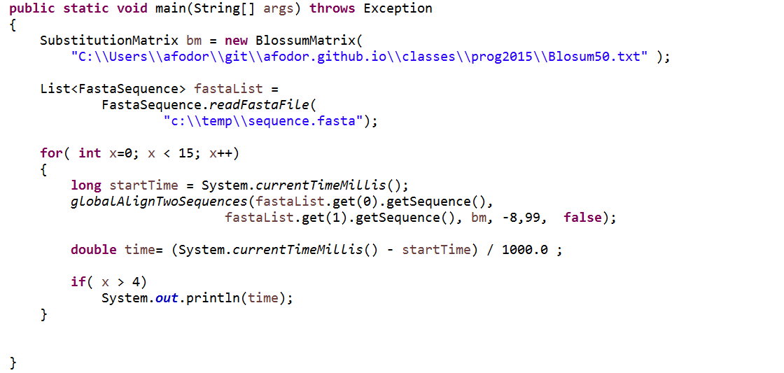
Performance testing on some file with 2 (longish ) sequences…
We allow a “burn-in” doing the alignment 5 times and then take 10 times

Slide 87
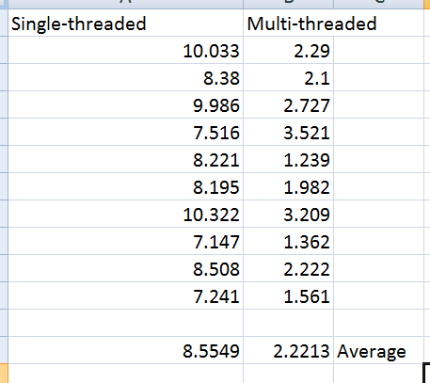
Two core machine (4 logical processors)
Multi-threaded:
Almost 4X speed-up! I have no good explanation of why the speed up is more than 2X.
Likely, some complex interaction with the multi-threaded garbage collector..
(Just running one trial, it looks like the speed up is closer to the expected 50%)
Multi-threaded: https://github.com/afodor/metagenomicsTools/blob/master/src/dynamicProgramming/NeedlemanWunschMultiThreaded.java
Single-threaded: https://github.com/afodor/metagenomicsTools/blob/master/src/dynamicProgramming/NeedlemanWunsch.java
Test file: https://github.com/afodor/metagenomicsTools/blob/master/src/dynamicProgramming/sequence.fasta

